Slide 1
DIGITEC: Digital Future Brussels 29 November 2016
Maive Rute,
Deputy Director-General

Slide 2

Digitisation of economy
Digital revolution is much faster than the industrial revolution and requires new tools and metrics to measure progresses and trends.
extrapolation from current trends is very risky.
Erosion of privacy a growing concern.
Increased dichotomy in markets: a few large platforms that control a myriad of small suppliers, diminished importance of SMEs.
"Platformisation" of the economy: data platforms will erode the market power of firms and affect a large part of the economy.
Robotisation not limited to manufacturing but invading services sectors, including public services.
More data but only few accessible for policy making creating inefficiency or increased costs in the PS

Slide 3
Use of digital data for policy:
Policy makers want to use digital data to monitor what is happening in the (digital) economy and to check policy implementation.
Regulatory interventions require market analysis first, to examine if there are market failures and if it is possible to overcome them.
Market analysis requires data on firms and consumer behaviour. In digital markets, these data are often collected and owned by online firms and are not publicly available.
The paradox of the digital economy is that never before have so much data been collected and never before has it been so difficult to access these data.
Regulations suffer from lack of access
The regulatory process is very slow compared to the digital market speed
Data could be obtained from firms but firms will not release data that might be used against them

Slide 4
JRC role in policy support
Collect (and curate) digital data)
Analyse them for policy purposes
Promote and adopt open access policies.
Build our capacity to manage data
Data needs to be curated and properly analysed. This requires investment in infrastructures and skills (data scientists).

Slide 5
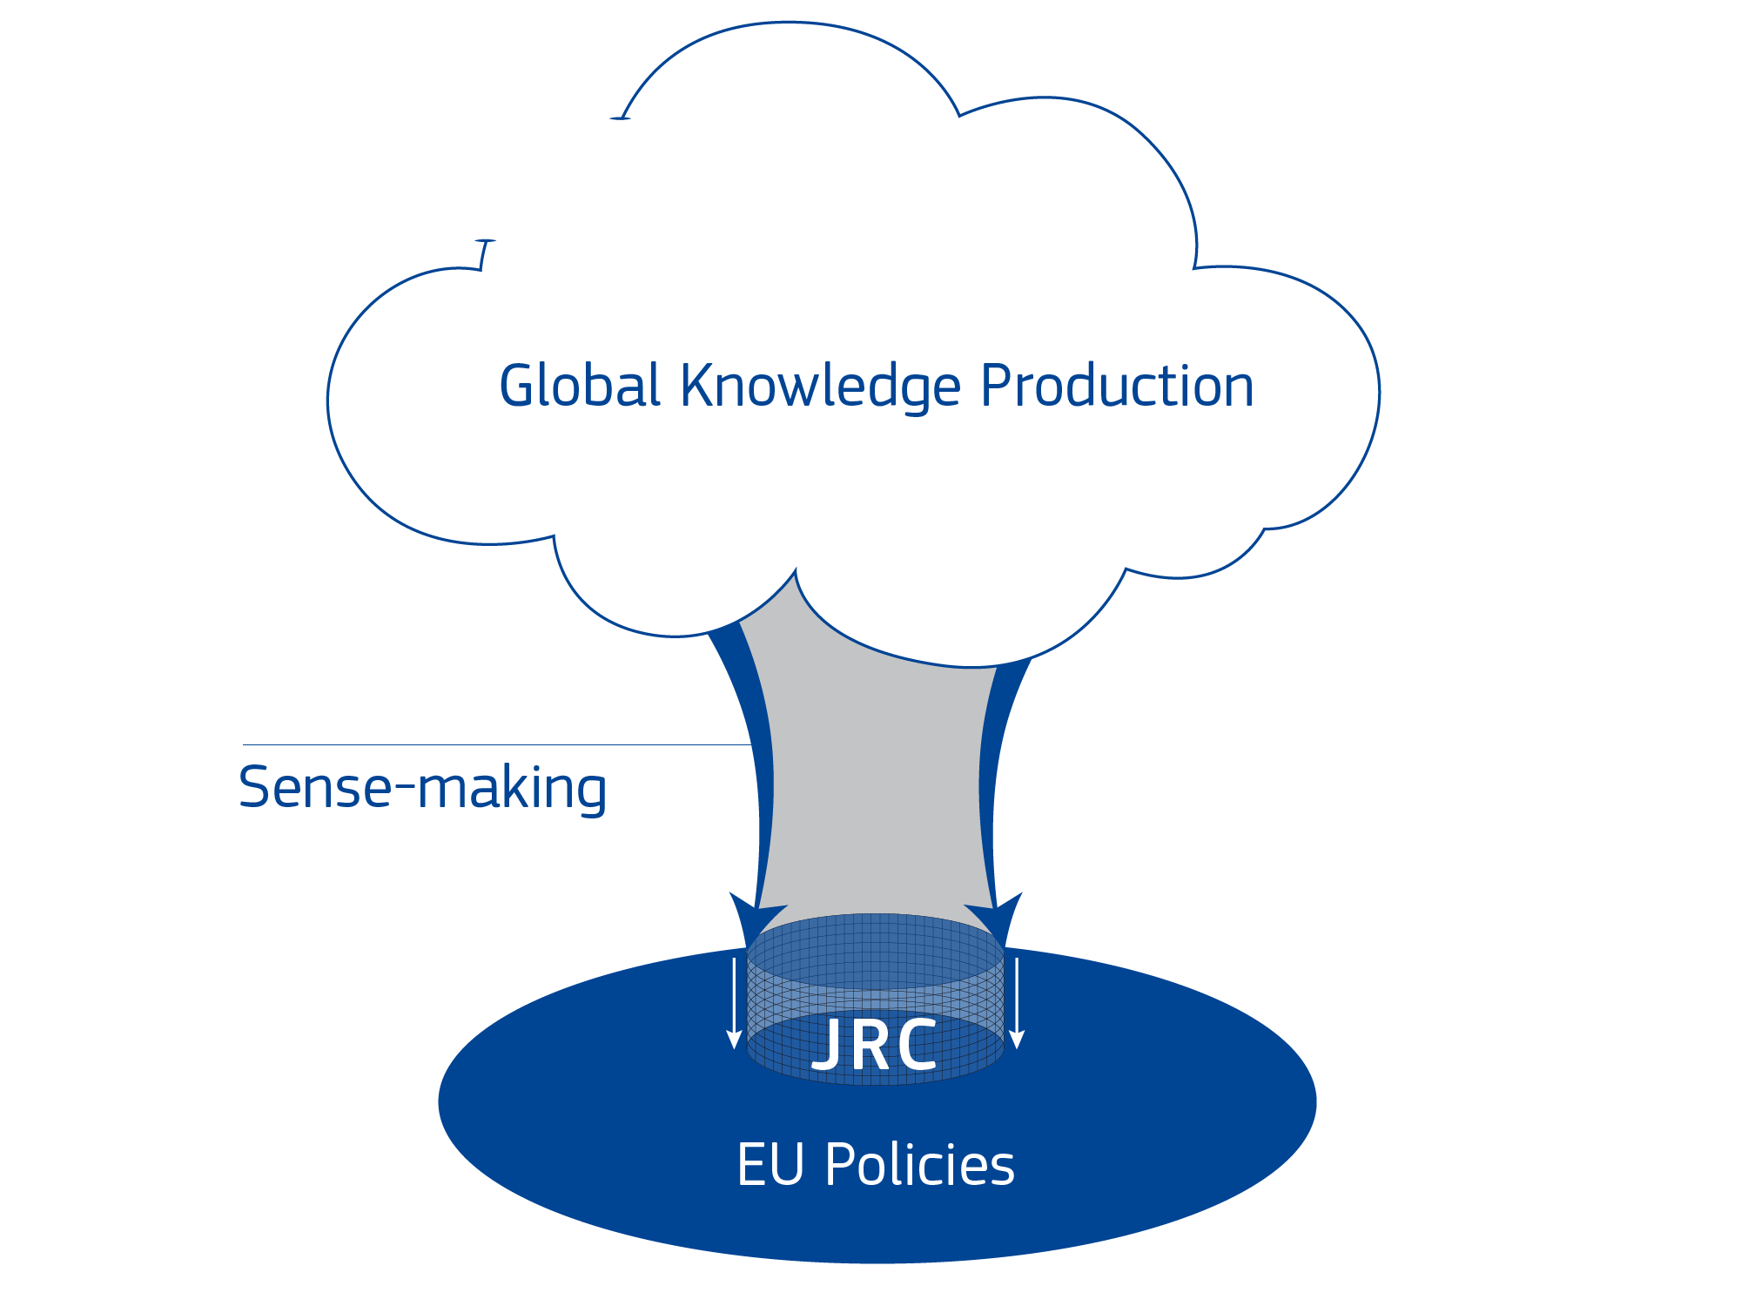

JRC's Knowledge Centres
Global knowledge production

Slide 6

Competence Centre on Composite Indicators and Scoreboards
Theoretical framework
Literature review, experts’ consultation
Data selection
Availability, coverage (over the full policy cycle! = data-planning)
Data checking
Outliers, missing data, and imputation based on peers
Data processing
Normalisation (0-100), weighting , aggregation, statistical coherence tests, uncertainty and sensitivity analysis
Visualisation
Online Tools, reports (Policy, Tech.), infographics

Slide 7
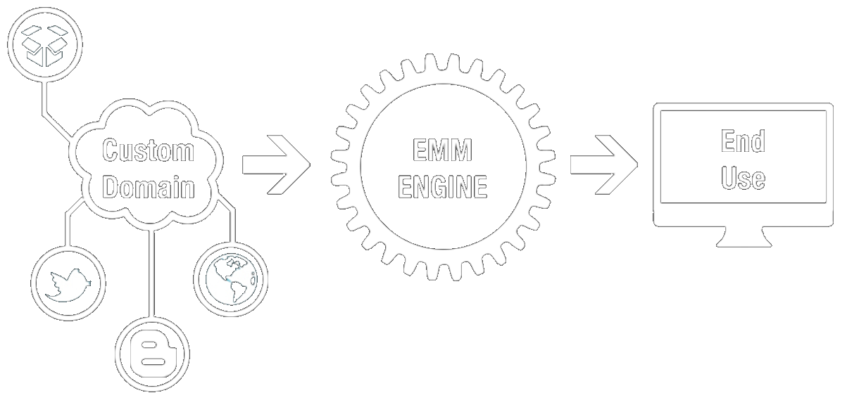
News wires
Sources | 6.000 News Sites
Input | 300.000 articles per day 55.000 tweets per day
Languages | 70
Categories | 1.000 classes
Classes | 30.000 keywords
Runs | 24/7
Visitors/day | 25.000

Slide 8



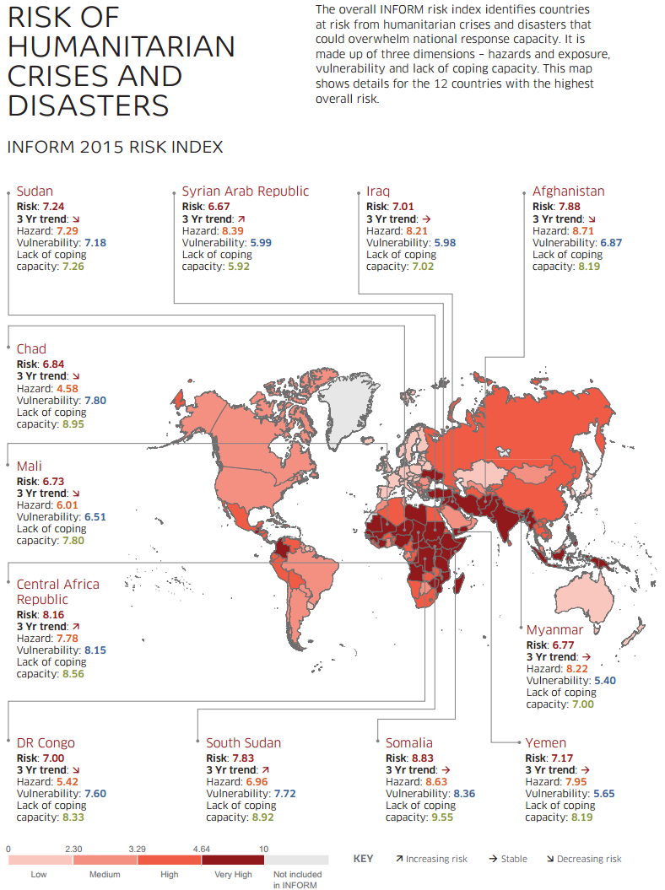
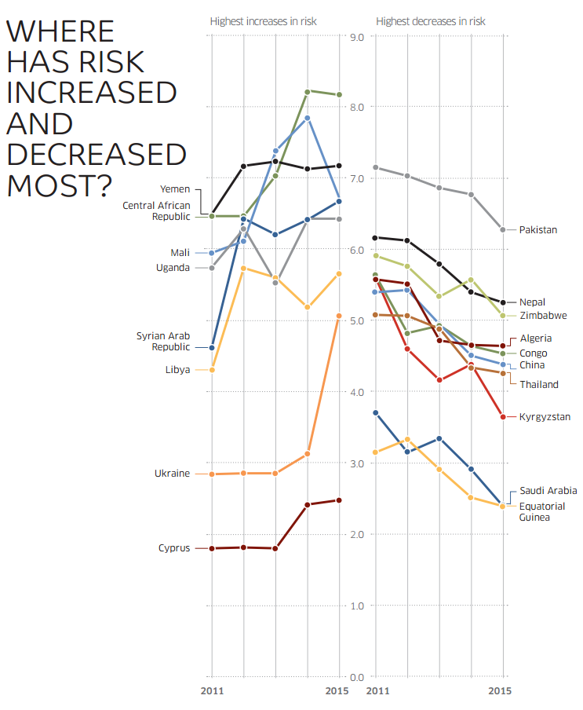

Slide 9
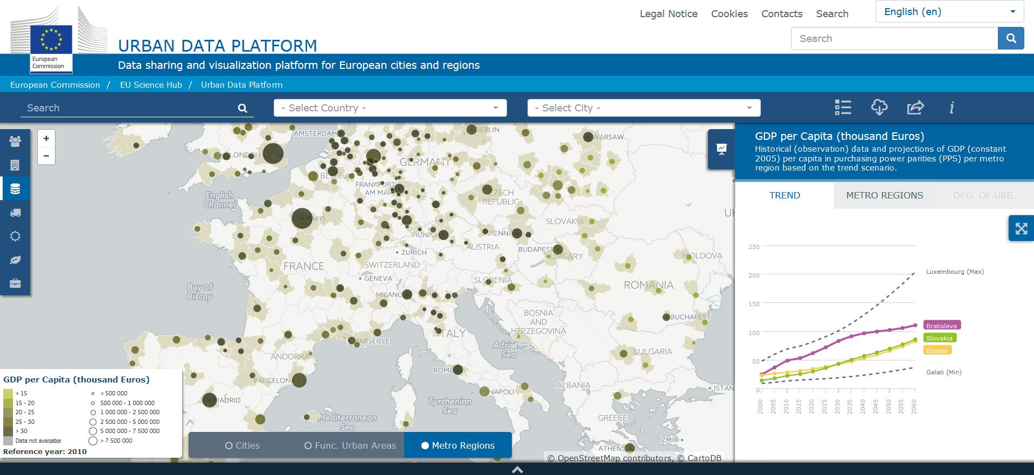
How is your city performing?
Explore the performance of your city in various fields such as demography, urban development, economic development and resource efficiency.
Compare more than 800 urban areas using 60 indicators.
http://urban.jrc.ec.europa.eu/

Slide 10
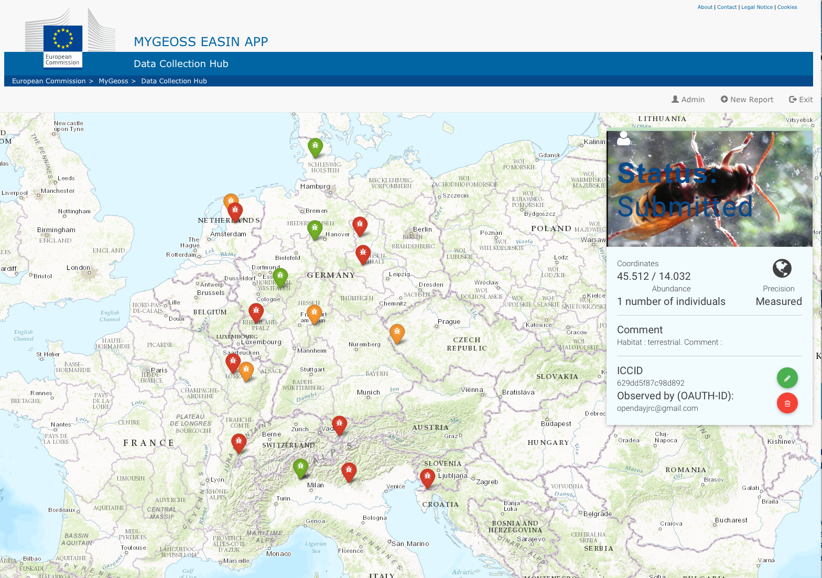


Slide 11
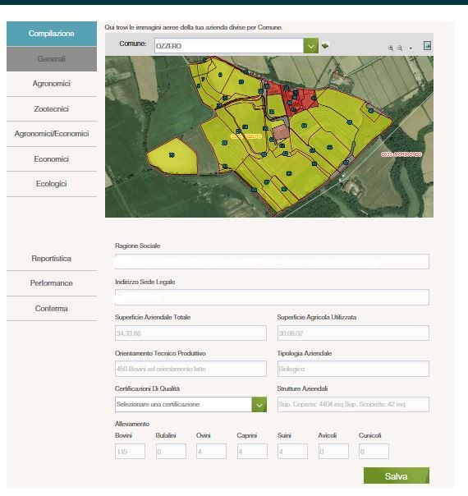

Slide 12
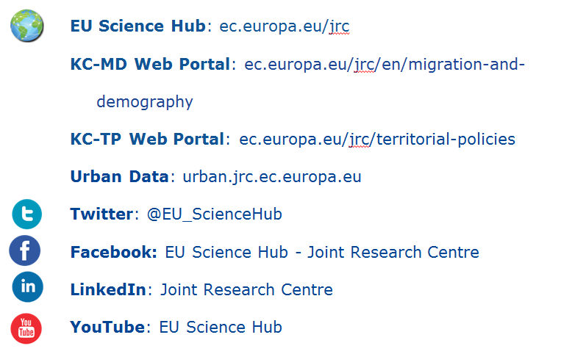
Stay in touch

